Slide 1





EDA mini project
Online Shopping
in the USA
Group 2

Slide 2
Table of Content
Objectives (P.3 - 4)
Data Description (P.5 - 7)
Methodology (P.9 - 14)
Analysis (P.16 - 36)
Challenges & Limitation (P.38 - 41)
Future Works (P.42 - 44)
Conclusion (P.45 - 47)
Reference (P.48 - 50)
Distribution of Works (P.51 - 52)

Slide 3




Objectives

Slide 4
Diagnose essential factors contributing to Revenue
Analyze transaction frequency (time-series)
Examine product sales performance
Study customer demographics
Investigate customer behaviors in different diversities, mainly focus on tenure and coupon.
Optimize business revenue (online shopping)

Slide 5



Dataset Description

Slide 6
Introduction
Sources from Kaggle
https://www.kaggle.com/datasets/jacksondivakarr/online-shopping-dataset/discussion?sort=hotness
A store revenue both online & offline in the USA
Data collection by web scraping

Slide 7
Characteristics
Categorial
Coupon_status
Gender
Product Category
Date
Date
Transaction_Date
Text
Coupon_Code
Location
Product_SKU
Product_Description
Numeric
Avg_Price
CustomerID
Delivery_Charges
Discount_pct
GST(Goods & Services Tax)
Offline Spends
Online Spends
Transaction_ID
Transaction_Months
Month

Slide 8
Characteristics(Con’t)
Numeric
Delivery_Charges
Discount_pct
GST(Goods & Services Tax)
Offline Spends
Online Spends
Transaction_ID
Transaction_Months
Text
Coupon_Code
Location
Product_SKU & Product_Description

Slide 9



Methodology

Slide 10
Data preprocessing & feature engineering steps
Data Cleaning
Create a new column by the following formula
Gross Revenue: [ [(Quantity * Average Price)*(1-Discount Rate in % {only "Used" is adopted} ) ] ] * (1+ GST in %) + Delivery Charge
Assume that delivery charge is paid by customer
Assume delivery charge is equal to its cost

Slide 11
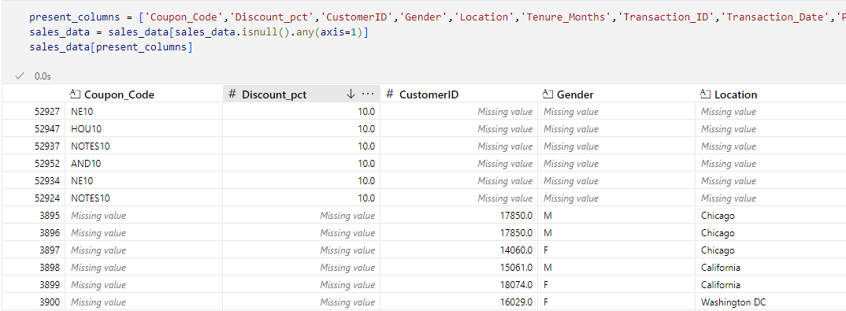
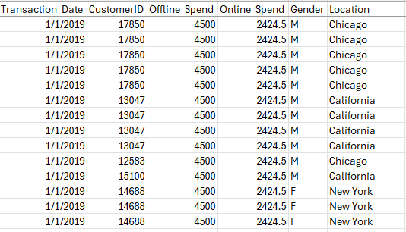
Data preprocessing & feature engineering steps(con’t)
Data Cleaning
Missing Values
Noisy Data

Slide 12
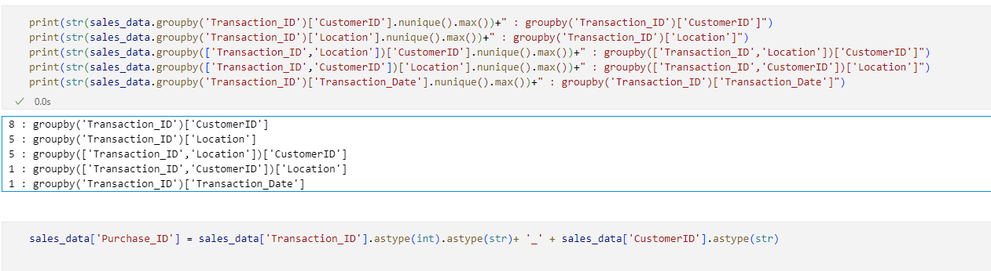
Data preprocessing & feature engineering steps(con’t)
Data Cleaning
Re-define the unique purchase ID

Slide 13
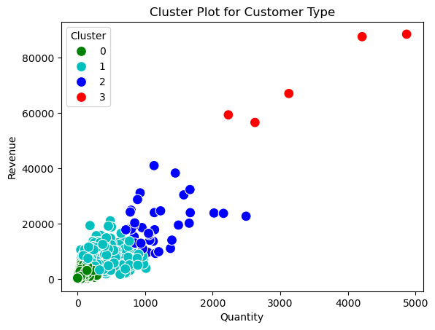
Data preprocessing & feature engineering steps(con’t)
Data Transformation
Discretization

Slide 14
Rationales behind
Rationale(s) behind

Slide 15


Analysis

Slide 16
9 Directions in the analysis
Average Price
Revenue by Gender / Weekday
Gross revenue
Product Categories
Customer Segments
Tenure Study (Customer Loyalty)
Coupon Study (Customer Incentive)
Yearly Sales Quantity
Product Category Association
Analysis

Slide 17
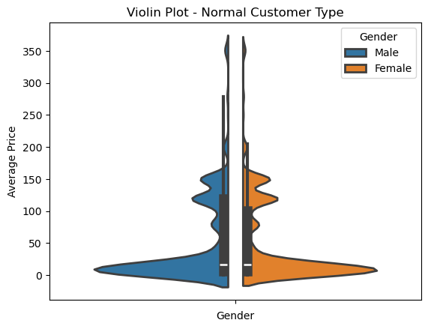
Analysis in Average Price
Notes:
Page Objective: Understand Revenue Trend over 1 year
—--------------------------------------------------------------------------
[ Foundings ]
Higher Revenue at the Start and End of the Year --> Seasonal Demand: Holiday ( US Total 10 Holidays in 2019 ; 3 Holidays in Q1 ; 4 Holidays in Q4 )
Will explain July, August revenue spike later

Slide 18
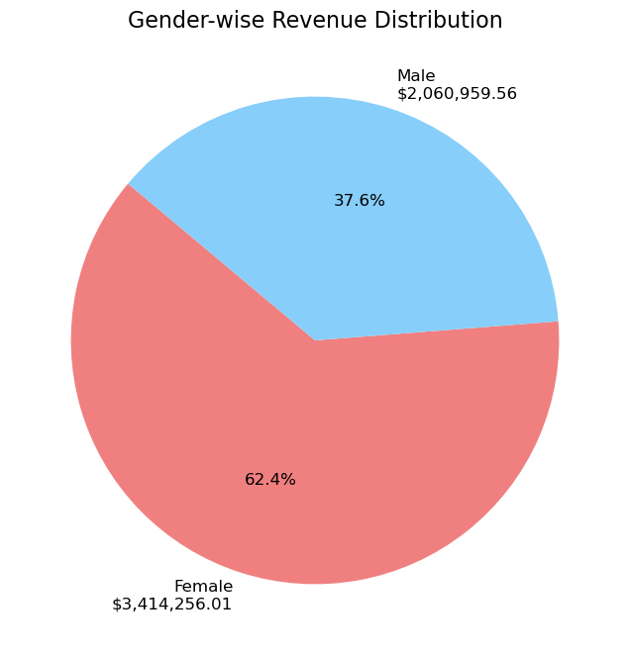
Analysis in Revenue by Gender
Notes:
The Gender-wise Revenue Distribution highlights a significant difference in revenue contributions between genders. Female customers generated a total revenue of $3,414,256.01, accounting for approximately 62.36% of the total revenue. In comparison, Male customers contributed $2,060,959.56, making up about 37.64% of the total revenue. This disparity underscores the importance of understanding gender-specific preferences and behaviors to optimize marketing strategies and enhance customer engagement.

Slide 19
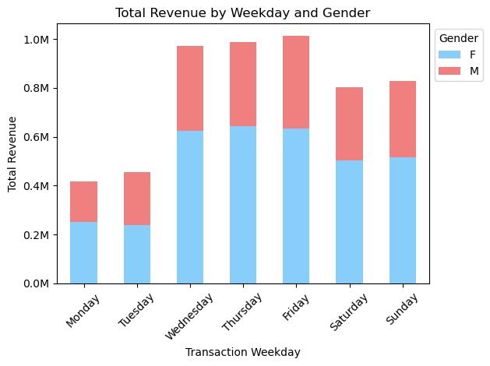
Analysis in Revenue Weekday
Notes:
Our analysis reveals a significant insight into customer behavior: the revenue generated on Mondays and Tuesdays is consistently half of what we observe on other days of the week. This trend highlights a potential opportunity to optimize our marketing strategies. By introducing targeted promotions, discounts, or campaigns specifically for these days, we can encourage more customer engagement and boost sales. Understanding and addressing this pattern will allow us to maximize revenue and create a more balanced sales distribution throughout the week.

Slide 20
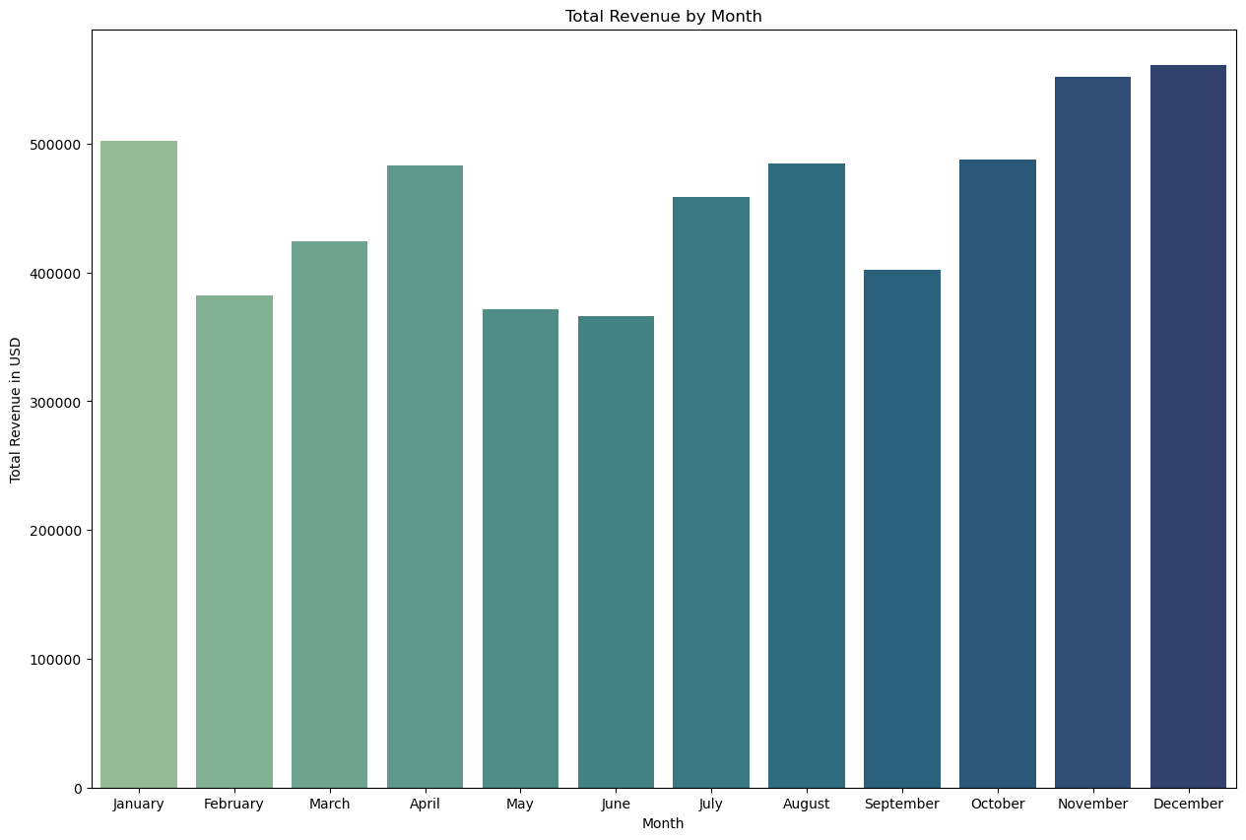
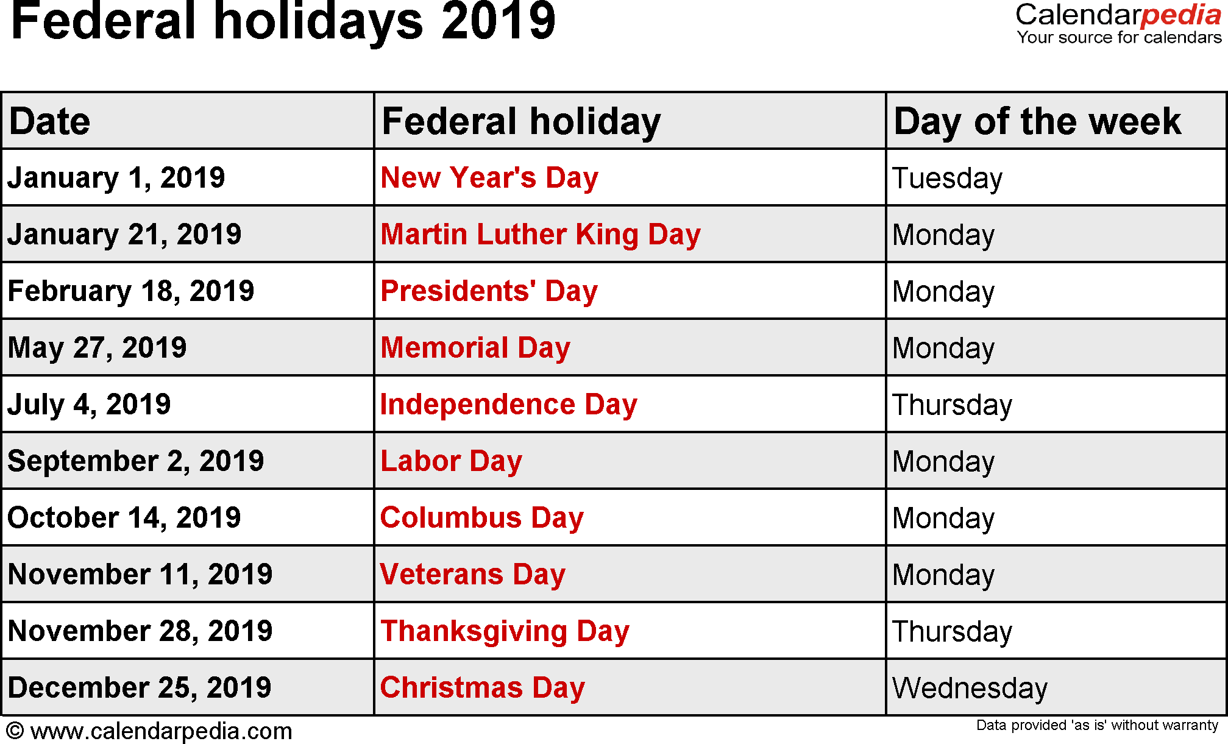
Analysis in Gross revenue
Notes:
Page Objective: Understand Revenue Trend over 1 year
—--------------------------------------------------------------------------
[ Foundings ]
Higher Revenue at the Start and End of the Year --> Seasonal Demand: Holiday ( US Total 10 Holidays in 2019 ; 3 Holidays in Q1 ; 4 Holidays in Q4 )
Will explain July, August revenue spike later

Slide 21
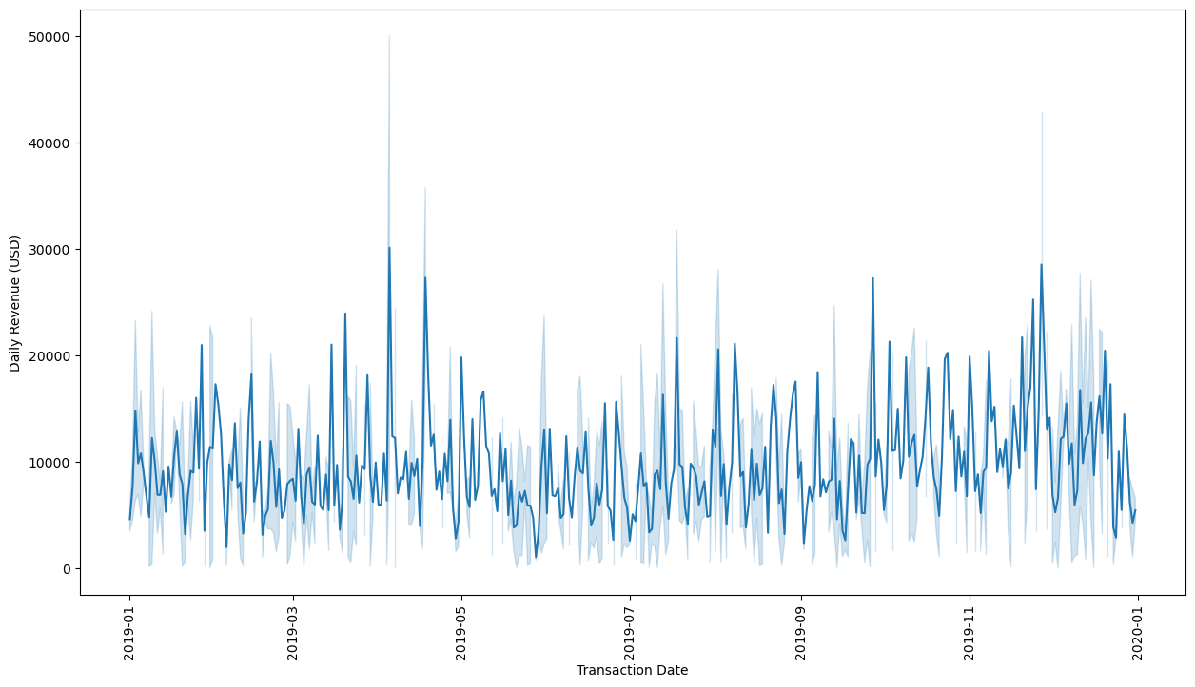
Analysis in Gross revenue
Transaction Date | Total Price | Outliner | Exceeds Upper IQR
2019-02-14 | 36,430.70 | Mild_Outlier | 2.125468294
2019-04-05 | 60,238.67 | Extreme_Outlier | 4.955195923
2019-04-18 | 54,760.93 | Extreme_Outlier | 4.304131921
2019-07-13 | 32,600.21 | Mild_Outlier | 1.67019036
2019-07-18 | 43,256.31 | Mild_Outlier | 2.93673516
2019-08-02 | 41,131.95 | Mild_Outlier | 2.684241554
2019-11-27 | 57,081.03 | Extreme_Outlier | 4.579890462
2019-12-11 | 33,493.57 | Mild_Outlier | 1.77637184
2019-12-18 | 32,314.82 | Mild_Outlier | 1.636269956
Notes:
Page Objective: Understand Revenue Trend over 1 year
—--------------------------------------------------------------------------
[ Foundings ]
Higher Revenue at the Start and End of the Year --> Seasonal Demand: Holiday ( US Total 10 Holidays in 2019 ; 3 Holidays in Q1 ; 4 Holidays in Q4 )
Will explain July, August revenue spike later

Slide 22
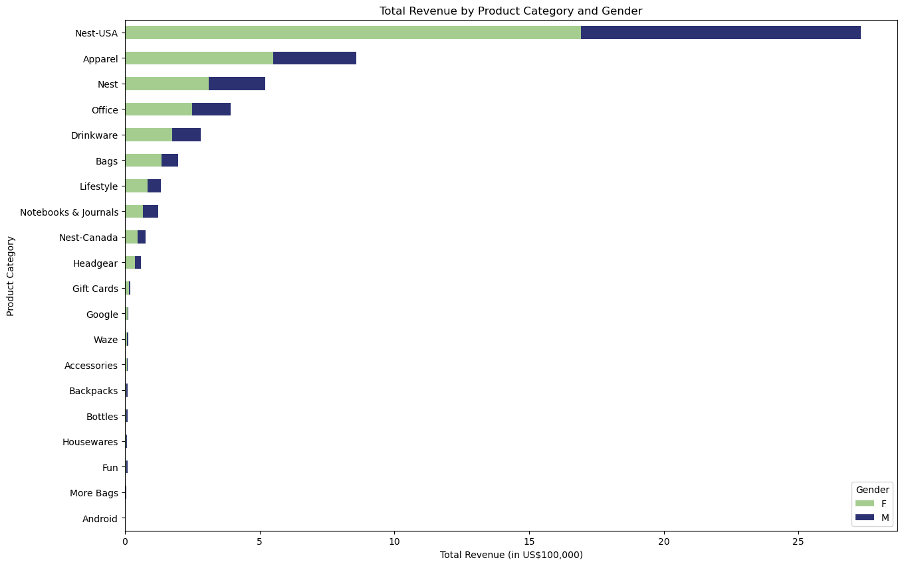
Analysis in Product Categories
Notes:
Page Objective: Understand Revenue by Product Categories & Gender
—--------------------------------------------------------------------------
1. Product Categories ( Top 3 and Worst 3 )
* Top 3: Nest-USA , Nest, Apparel categories contribute the top 3 revenue amount among all categories. Worth emphasis.
* Worst 3: Fun, More Bags, Android categories contribute the least. Might have to strictly control our inventory planning of these products.
2. Gender
* Female customers > Male customers in total and in most of the product categories

Slide 23
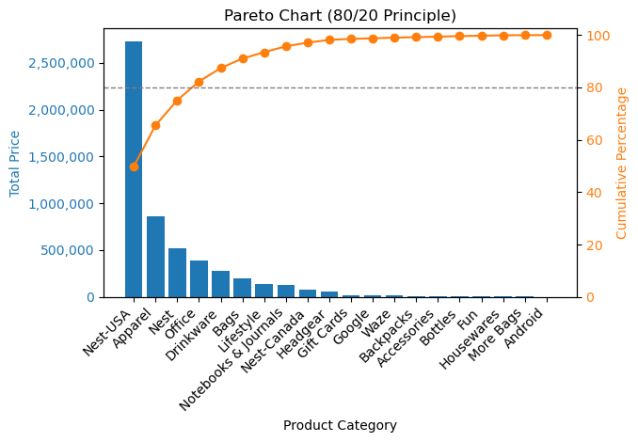
Analysis in Product Categories
Notes:
Page Objective: Understand Revenue by Product Categories
—--------------------------------------------------------------------------
1. Product Categories ( Top 3 and Worst 3 )
* Top 3: Nest-USA , Nest, Apparel categories contribute the top 3 revenue amount among all categories. Worth emphasis.
* Worst 3: Fun, More Bags, Android categories contribute the least. Might have to strictly control our inventory planning of these products.
------------------------------------------------------------------------------
2. Gender
* Female customers > Male customers in total and in most of the product categories

Slide 24
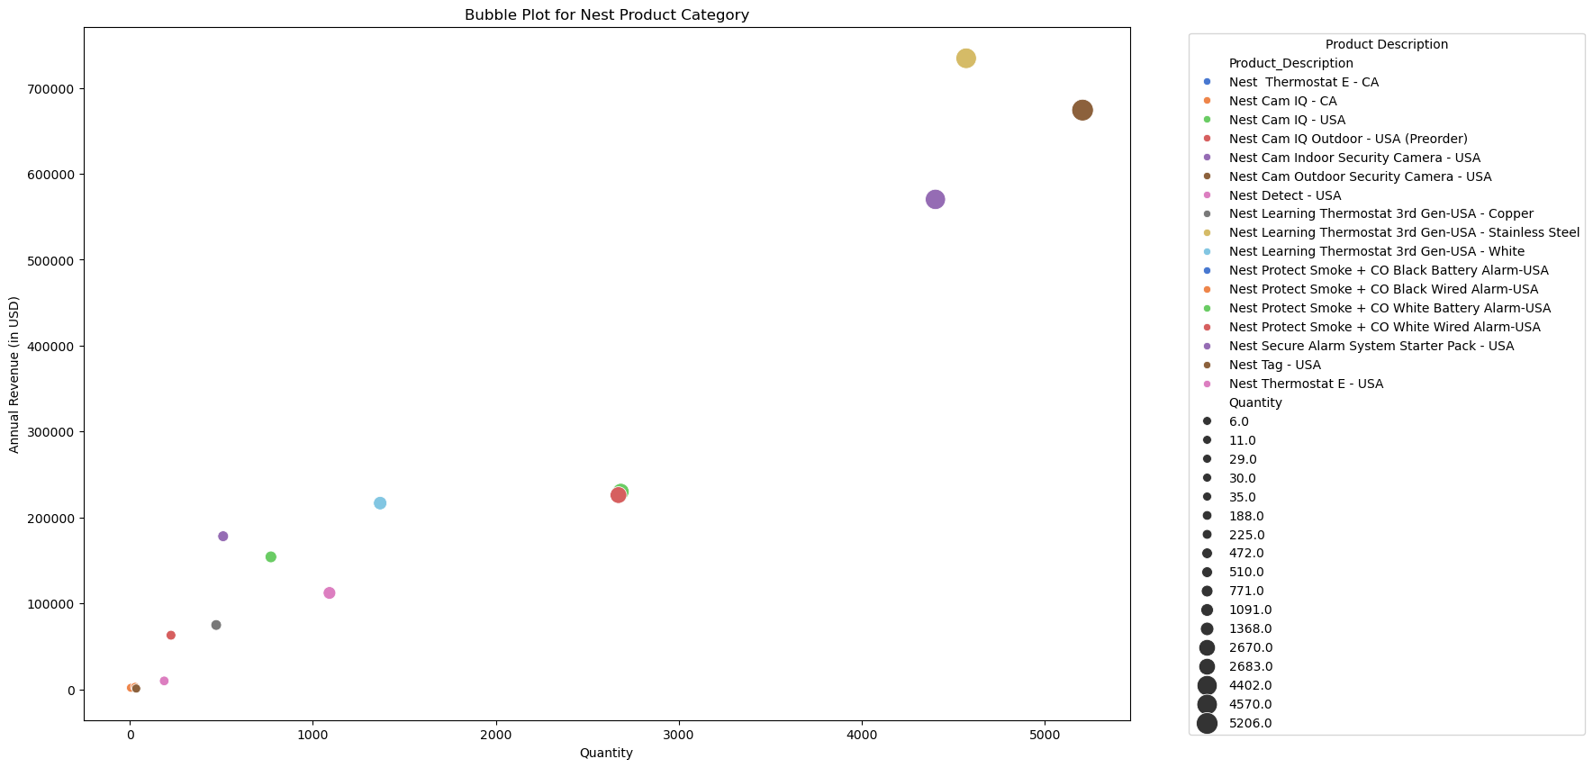
Analysis in Product Categories
Notes:
Page Objective: Let's break down top 3 product categories to check their respective product sales performance. This page, we focus on Nest Product Category (Top 1, Top 3)
—-----------------------------------------------------------------------------------------------------------------------------------
Nest Products:
Key Popular products are Security Camera, Learning Thermostat, Cam IQ.
* Security Camera : Both Outdoor and Indoor had high demand, but Outdoor's demand was higher
* Thermostat : Stainless Steel > better than all the other learning thermostat and thermostat.
* Camera : USA / CA version are roughly the same.
--> understanding these best-selling information could boost our sales via selecting them in our product marketing or recommendation in a face-to-face scenario.

Slide 25
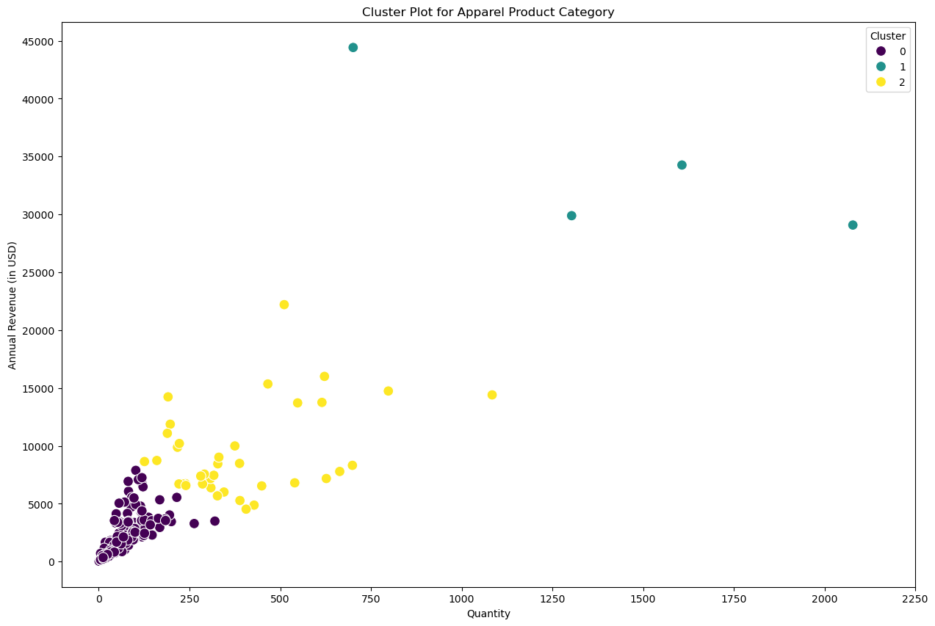
Analysis in Product Categories
Notes:
Page Objective: This page, we focus on Apparel Product Category (Top 2)
This Product Category has are more than 200 row (i.e. 200 categories).
It is hard to observe each category manually, thus cluster plot is used to find the appropriate cluster and practice for this product category.
—----------------------------------------------------------------------------------------------------------------------------------------------------------------------------------------
From the Cluster Analysis:
We can divide the Apparel category into 3 groups:
1. Those in purple 0 ( quantity <250 ) and ( Annual Revenue < 6000 )
2. in Yellow 2 ( 250 < quantity < 1250 ) amd (6000 < Annual Revenue < 2500)
3. Rest in green 1 that is scattered (bulk quantity and revenue from 30000 - 45000)
In order to maximize revenue of the business
* Business focus (i.e. Marketing & Inventory Planning ) on group 1 & 2 should be equally important because although group 2 has more number of categories and its aggregated outcome is similar to group 1 indeed.
* In all groups, those points above the diagonal (with higher annual revenue in the same x-axis) should be emphasized. It is because they generate higher revenue with same quantity sold.

Slide 26
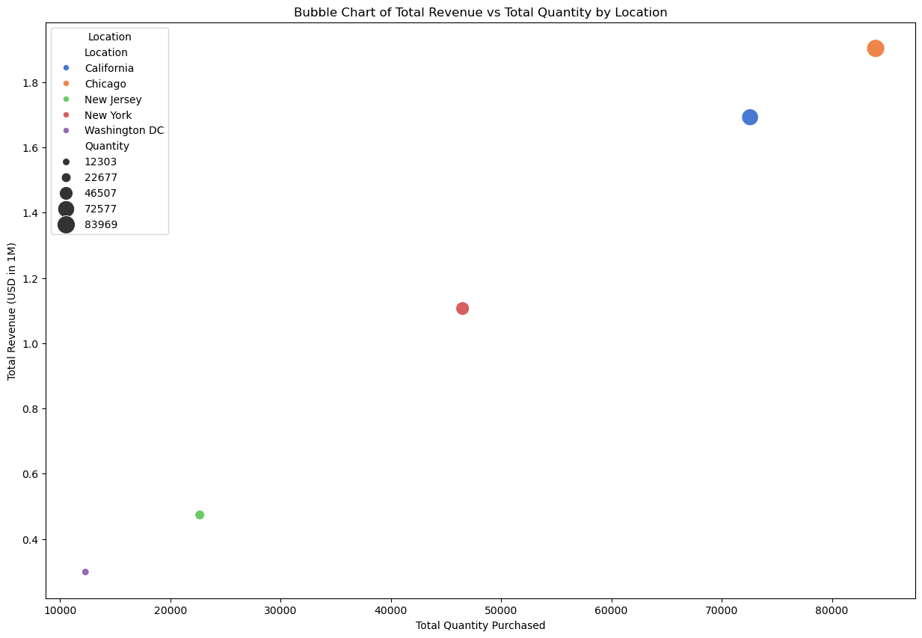
Analysis in Customer Segments
Notes:
Page Objective: Understand customer segments by location → their total quantity purchased and total revenue generated
—-----------------------------------------------------------------------------------------------------------------------------------------
1. Revenue by Customer Location: Chicago > California > New York > New Jersey > Washington DC
—------------------------------------------------------------------------------------------------------------------------------------------
(Next Page)
2. Positive correlation between total quantity purchased and total revenue.
Revenue = Total Quantity x Average Price (Roughly)
It is observed when the total quantity increases, the average price purchased by customer doesn't decrease due to Economies of Scale for the current stage of the business. In ideal situation, the increase in quantity together with a decrease in purchase price should come with a higher total total revenue. Otherwise, it doesn't make sense for a company to offer bulk quantity with a lower per unit price. (i.e. the curve should tend to less steeper in slope as quantity increases). It could possibly implies that the business scale hasn't reached its maximum, and the portfolio mix of products bought by each location are roughly the same.
However, the number of locations in the US where customer brought our products from are just 5. The No. of observations might not be confident enough to form a comprehension prediction to other locations in the US based on the estimated quantity purchased by customers in case a business is running there.

Slide 27
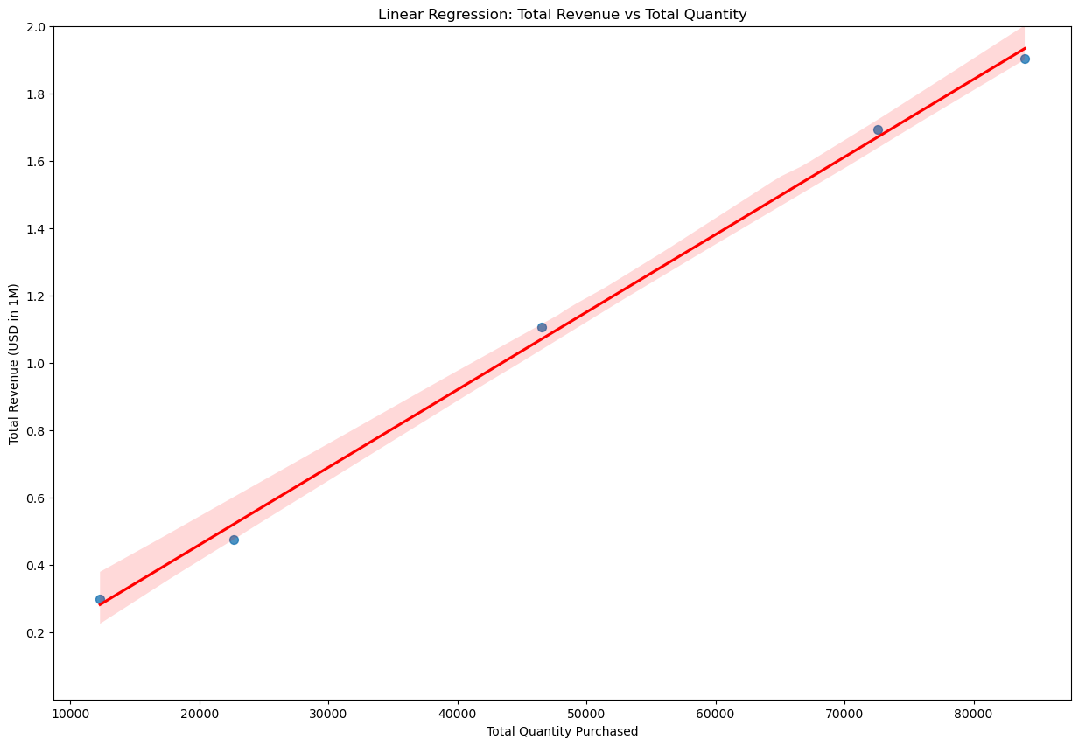
Analysis in Customer Segments
Notes:
Page Objective: Follow-up of the previous page
—------------------------------------------------------------------------------------------------------------------------------------------
(This Page)
(From the 5 locations, i.e. 5 points in the graah) Positive correlation between total quantity purchased and total revenue.
Revenue = Total Quantity x Average Price (Roughly)
It is observed when the total quantity increases, the average price purchased by customer doesn't decrease due to Economies of Scale for the current stage of the business. In ideal situation, the increase in quantity together with a decrease in purchase price should come with a higher total total revenue. Otherwise, it doesn't make sense for a company to offer bulk quantity with a lower per unit price. (i.e. in this case, the curve should tend to less steeper in slope as quantity increases). It could possibly implies that the business scale hasn't reached its maximum, and the portfolio mix of products bought by each location are roughly the same.
However, the number of locations in the US where customer brought our products from are just 5. The No. of observations might not be confident enough to form a comprehension prediction to other locations in the US based on the estimated quantity purchased by customers in case a business is running there.

Slide 28
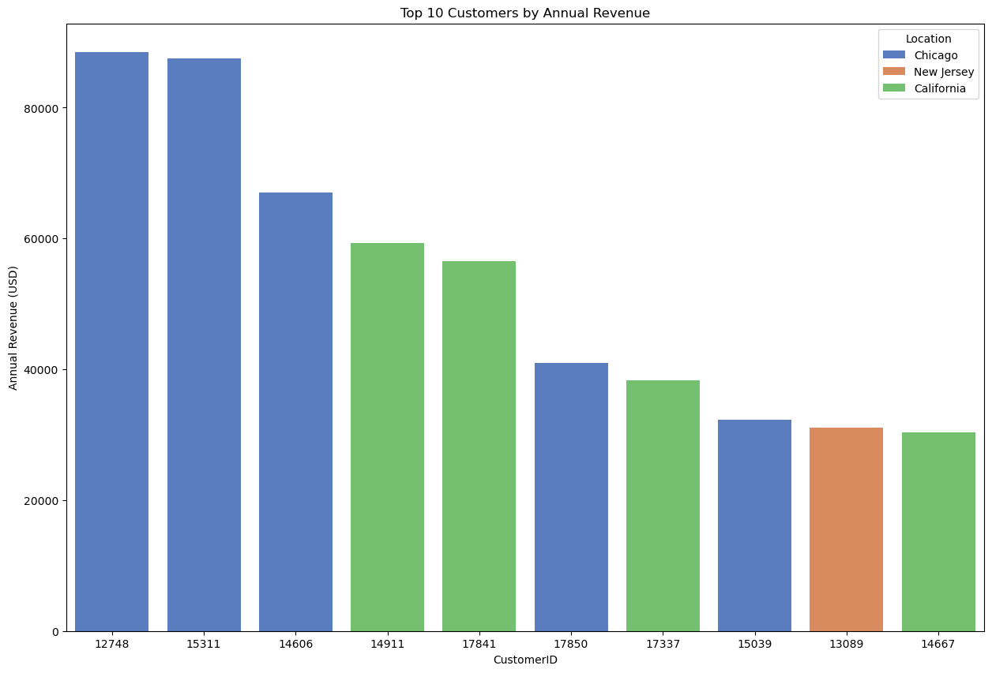
Analysis in Customer Segments
Notes:
Page Objective: Understand Top 10 Customer
—------------------------------------------------------------------------------------------------------------------------------------------
1. Majority of Top 10 customers come from Chicago and California, which is similar to the descending order of location total revenue.
These customers should be treated with priority and superior services.
2. Another spotlight is customer 13089 from New Jersey
New Jersey was ranked fourth in the location revenue, but this customer outperformed customers from the 3rd location.
This customer accounts for 5% of the total revenue of New Jersey

Slide 29
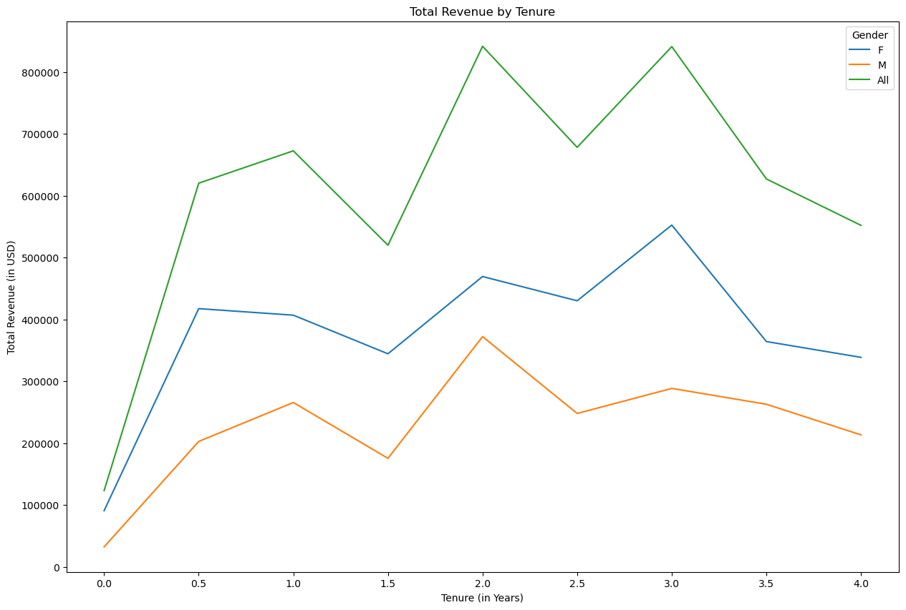
Analysis in Tenure Study
Notes:
Page Objective: Understand the impact of Customer Loyalty to Revenue (Customer Loyalty is measured by Tenure Years)
—------------------------------------------------------------------------------------------------------------------------------------------
Generally, higher tenure, higher total revenue.
The measure is especially material for every 1 year increment. (e.g. Year 0 < Year 1 < Year 2 ...)
However, this dataset only contains 1 year of data. Even though:
1. there are spikes for gender Female / Male over time
2. there are downturns in year 4 for all genders
it is hard to determine they are recurring phenomenon. They could be one-off.
All in all, it is more confident to say that customer loyalty in terms of tenure is generally significant to total revenue.

Slide 30
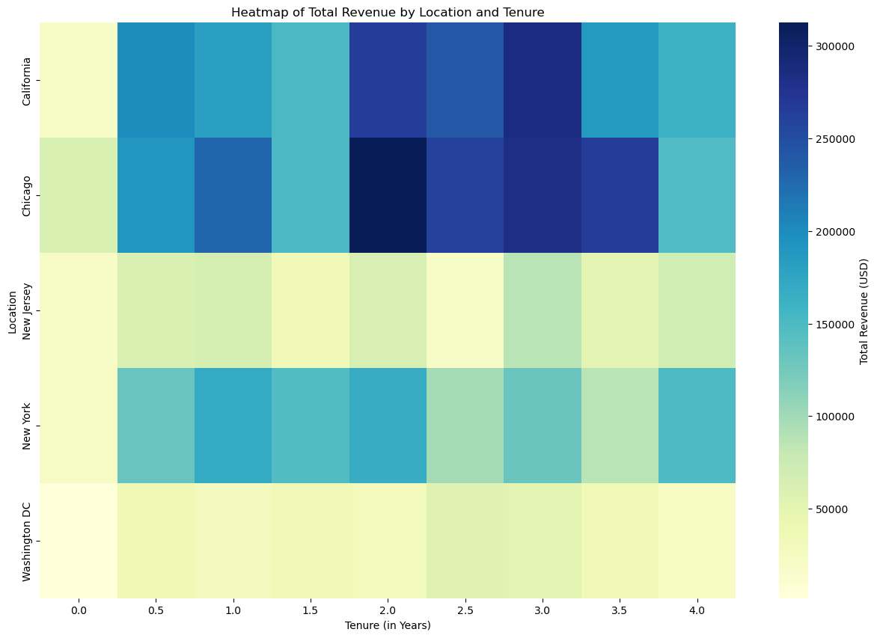
Analysis in Tenure Study
Notes:
Page Objective: Understand the impact of Customer Loyalty to Revenue (Breakdown by Locations)
—------------------------------------------------------------------------------------------------------------------------------------------
The effect of "higher tenure, higher total revenue" is relatively obvious in the location (Chicago , California , New York)
whereas New Jersey and Washington DC are less obvious. It could be due to different service treatments to different locations.
Since customer loyalty is important to total revenue, company has to find ways to improve in these two locations, e.g. incentive / campaign.

Slide 31
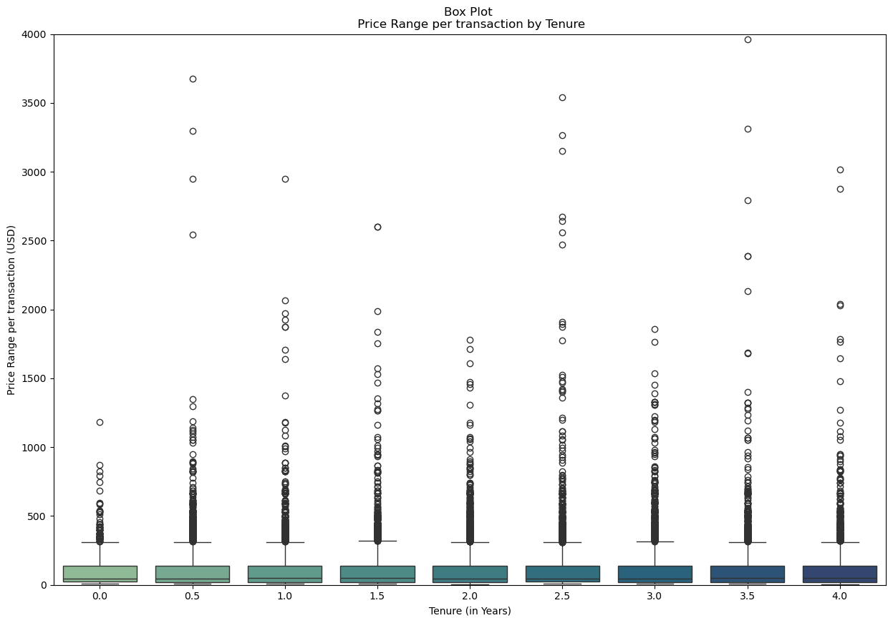
Analysis in Tenure Study
Notes:
Page Objective: Understand the impact of Customer Loyalty to Revenue (Breakdown by Price Range per Transaction)
—------------------------------------------------------------------------------------------------------------------------------------------
The Price Range per transaction is almost the same in majority of the situation across customer with tenure years between less than 1 year to 4 years.
However, it is observed that the upside deviation increases obviously since tenure years has reached 1 compared to those below 1 year.
It is believed that customer loyalty is impactful. Customer with higher tenure years typically tend to be more generous and consume more when demand is special. It could be like e.g. personal reason,for holiday celebration.

Slide 32
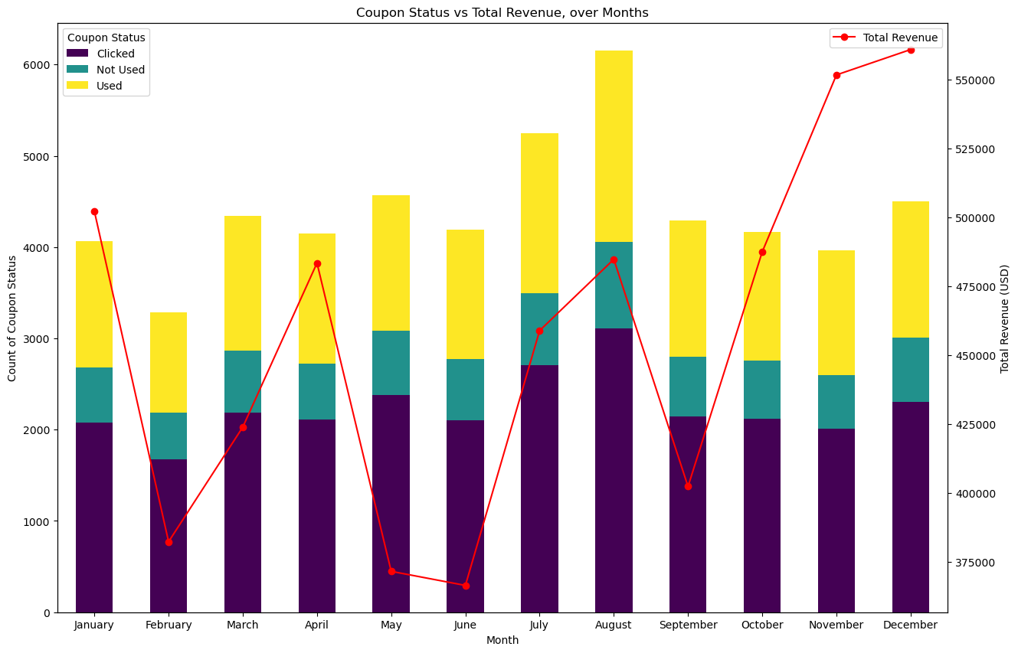
Analysis in Coupon Study
Notes:
Page Objective: Understand the impact of Coupon (Customer Incentive) to Revenue over time
—------------------------------------------------------------------------------------------------------------------------------------------
The distribution of coupons (including all kinds of its status - Used, Clicked, Not Used) is almost the same across the whole year, except February, July and August.
* As mentioned at the beginning of this presentation, (red line - total revenue) due to seasonal factor like holiday, there is Higher Demand at the Start and End of the Year.
And now, we further observe Q2 & Q3 solely (red line) . While Q2 and Q3 generally stay at a relatively lower annual revenue level compared to Q1 & Q4, the increase in use of coupon (the bars) in July and August could actually boost revenue. (i.e. Jul and Aug revenue are around the highest level among Q2 and Q3).
Also, the decrease in use of coupon in February ((the bar) also came with a lower revenue in Q1.
It is confident that coupon incentive plays a vital role in boosting revenue.
* On the other hand, with our assumption that there is higher demand in Q1 & Q4 of the year, it is also observed the total amount of coupons in each individual month (total of all kinds of status) remain roughly the same as in months of other quarters. Since it is confident that coupon incentive could boost revenue, it is believed that there is room for improvement in issuing more appropriate coupon incentive in Q1 & Q4 to boost more revenue.

Slide 33
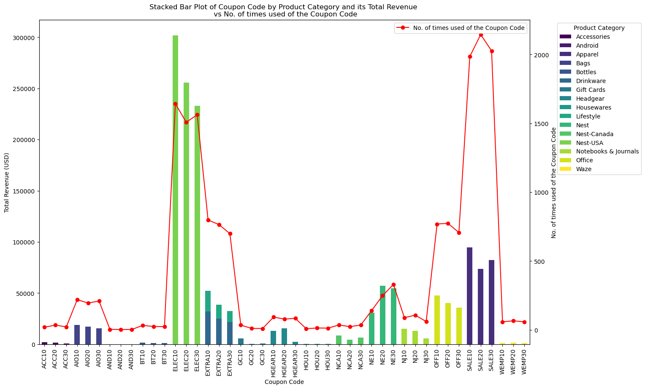
Analysis in Coupon Study
Notes:
Page Objective: Understand which specific Coupon Codes are the most effective (i.e. most used and noteable revenue)
—------------------------------------------------------------------------------------------------------------------------------------------
** The bars only show the used number of coupon code (we filter out status like clicked & not used)
The most effective Coupon Code (most used and noteable revenue)
1. ELEC 10 to ELEC 30 : mainly used for Nest Electrical Products
2. SALE 10 to SALE 30 : used for a wide spectrum of products offered by the business (mainly Accessories, Android, Apparel), it is for general usage purpose
It is believed that by issuing more similar coupon code covering these products and together with similar terms in the coupon code could help to boost revenue.

Slide 34
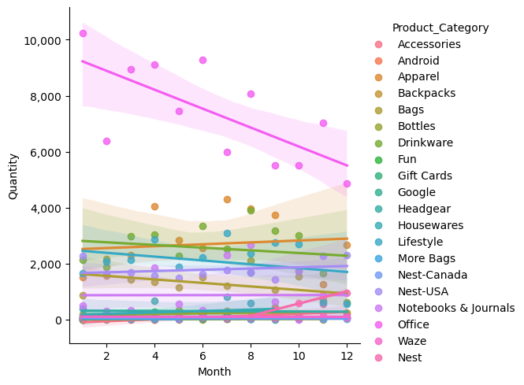
Analysis in Product Category
Notes:
Office is decreasing. Even the coupon is provided.

Slide 35
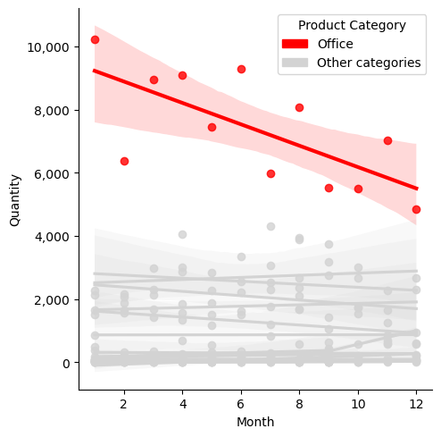
Analysis in Product Category
Notes:
Office is decreasing. Even the coupon is provided.

Slide 36
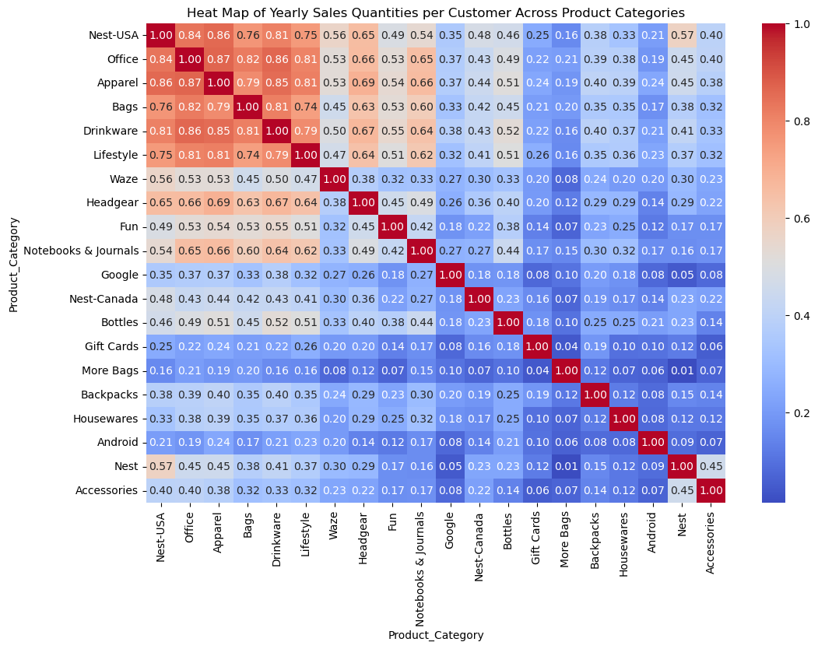
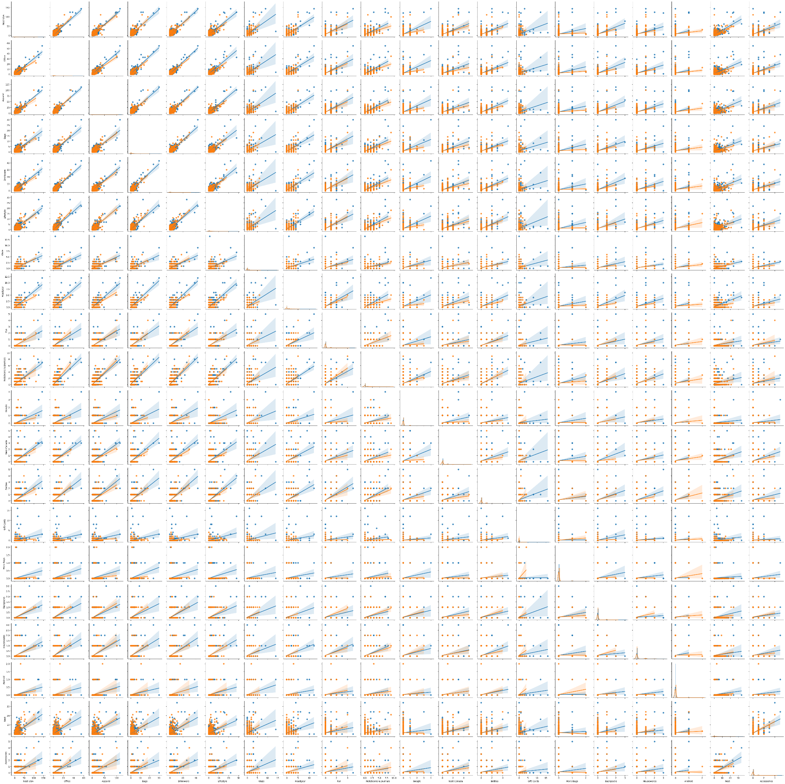
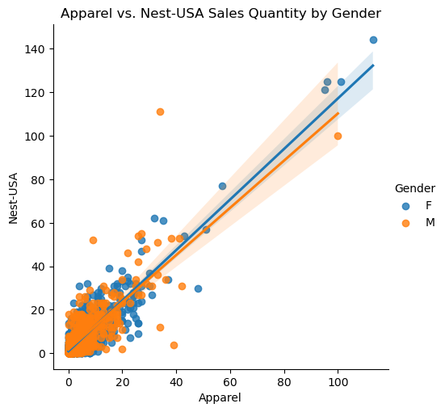
Analysis in Product Category Association
Notes:
Page Objective: Understand which specific Coupon Codes are the most effective (i.e. most used and noteable revenue)
—------------------------------------------------------------------------------------------------------------------------------------------
** The bars only show the used number of coupon code (we filter out status like clicked & not used)
The most effective Coupon Code (most used and noteable revenue)
1. ELEC 10 to ELEC 30 : mainly used for Nest Electrical Products
2. SALE 10 to SALE 30 : used for a wide spectrum of products offered by the business (mainly Accessories, Android, Apparel), it is for general usage purpose
It is believed that by issuing more similar coupon code covering these products and together with similar terms in the coupon code could help to boost revenue.

Slide 37
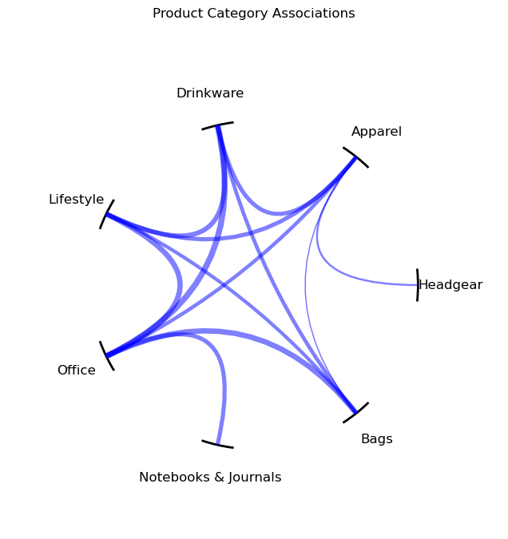
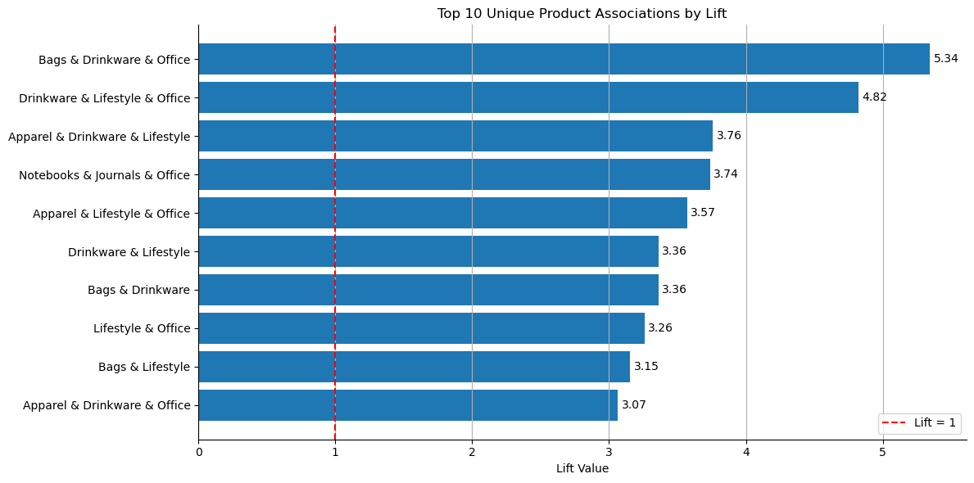
Association Rules of Product Categories in Single Purchase Orders
Notes:
Page Objective: Understand which specific Coupon Codes are the most effective (i.e. most used and noteable revenue)
—------------------------------------------------------------------------------------------------------------------------------------------
** The bars only show the used number of coupon code (we filter out status like clicked & not used)
The most effective Coupon Code (most used and noteable revenue)
1. ELEC 10 to ELEC 30 : mainly used for Nest Electrical Products
2. SALE 10 to SALE 30 : used for a wide spectrum of products offered by the business (mainly Accessories, Android, Apparel), it is for general usage purpose
It is believed that by issuing more similar coupon code covering these products and together with similar terms in the coupon code could help to boost revenue.

Slide 38
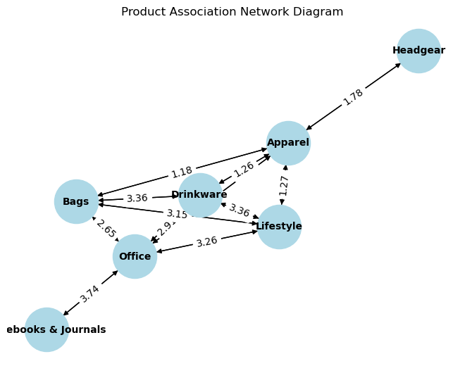
Analysis in Association Rule of Product Category
Notes:
Page Objective: Understand which specific Coupon Codes are the most effective (i.e. most used and noteable revenue)
—------------------------------------------------------------------------------------------------------------------------------------------
** The bars only show the used number of coupon code (we filter out status like clicked & not used)
The most effective Coupon Code (most used and noteable revenue)
1. ELEC 10 to ELEC 30 : mainly used for Nest Electrical Products
2. SALE 10 to SALE 30 : used for a wide spectrum of products offered by the business (mainly Accessories, Android, Apparel), it is for general usage purpose
It is believed that by issuing more similar coupon code covering these products and together with similar terms in the coupon code could help to boost revenue.

Slide 39


Challenges & Limitations

Slide 40
Discussion of challenges
Lack of informations
running costs & original price to calculate the net profit.
Determinations in spends
Online spends & Offline spends columns are undefined in the dataset.
Idiopathic reasons of not using coupons
Majority of customers clicked the coupons without using it.

Slide 41
Limitations of the approach or dataset
Missing information such as product cost, who paid the delivery fee.
Offline & Online spends in determination
Lack of cost information to calculate net revenue column

Slide 42
Potential areas for future improvement
Find out the definition of the offline & online spends
Assessment about pre- & post-order customer service satisfaction to stimulate sales.
Questionnaires about further improvement on delivery service, product durability & website design to maintain the customers’ loyalty.

Slide 43


Future Work

Slide 44
Additional ideas with Reason not implementing
Deeply investigation of Individual Products
There could be a hundred of individuals in one product category.
Reason: Time constraint

Slide 45
Recommendations
Assessment about pre- & post-order customer service satisfaction to stimulate sales.
Questionnaires about further improvement on delivery service, product durability & website design to maintain the customers’ loyalty.

Slide 46




Conclusion

Slide 47
Summary of the project's objectives and achievements
Objectives:
Diagnose essential factors contributing to Revenue. Afterwards, provide business owners with data-driven recommendation for Revenue Maximization (thus Net Profit).
Achievements:
Identified best business approaches in the aspects of total revenue, product categories, customer segments, customer loyalty and customer incentives.

Slide 48
Key takeaways & insights gained
Revenue | Seasonal Demand
Product Categories | Best Selling Products (Nest & Apparel)
Customer Segments | Top Locations, Top Customers
Customer Loyalty | Tenure matters
Customer Incentives | Coupon matters Best Coupon Code (ELEC & SALE)

Slide 49

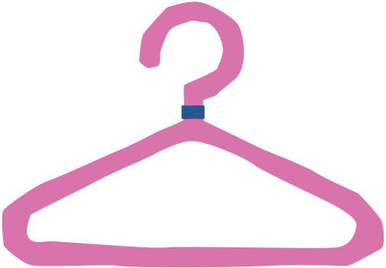
Reference

Slide 50
Reference
Hossain, M. A., Akter, S., & Rahman, S. (2022). Customer behavior of online group buying: an investigation using the transaction cost economics theory perspective. Electronic Markets, 1-15.
R, J. D. (2023, November 12). online shopping dataset . Exploring Online Shopping Trends and Patterns. https://www.kaggle.com/datasets/jacksondivakarr/online-shopping-dataset .

Slide 51
Reference
Liu, S., Peng, D., Zhu, H., Wen, X., Zhang, X., Zhou, Z., & Zhu, M. (2021). MulUBA: multi-level visual analytics of user behaviors for improving online shopping advertising. Journal of Visualization, 24(6), 1287-1301. Riegger, A. S., Merfeld, K., Klein, J. F., & Henkel, S. (2022). Technology-enabled personalization: Impact of smart technology choice on consumer shopping behavior. Technological Forecasting and Social Change, 181, 121752.

Slide 52




Distribution of Work

Slide 53
Distribution of Work
All of us share even distribution of work in all the aspects! Great Teamwork!

Slide 54



Q & A Sessions
and
Thanks you!

